Slide 1




NEXT GEN EMPLOYABILITY PROGRAM
Creating a future-ready workforce
Team Members
College Name
Student Name : :A. Apshana
Student ID : au951221104005
JP College Of Engineering

Slide 2

CAPSTONE PROJECT SHOWCASE
Project Title
Voting Web Application using Django Framework
Abstract | Problem Statement | Project Overview | Proposed Solution | Technology Used | Modelling & Results | Conclusion

Slide 3
Abstract
A voting web application built with the Django framework provides a platform for users to participate in various polls and elections online. It includes features for user authentication, allowing registered users to create, view, and vote on polls. The application also includes an admin interface for managing polls and users, ensuring security and integrity. With Django’s robust framework, developers can easily scale and customize the application to meet specific voting requirements while maintaining reliability and performance
Source :

Slide 4
Problem Statement
The problem statement revolves around the need to develop a secure, accessible, and user-friendly online voting web application utilizing the Django framework. Traditional voting methods face challenges in terms of accessibility, security, and transparency. The objective is to address these issues by creating a robust digital platform that ensures the integrity of the voting process, authenticates users securely, and provides real-time updates on voting progress and results. Design and develop a Django-based web application for secure and efficient online voting, including user registration, authentication, and management of various voting processes such as elections and polls. Ensure robust security measures, intuitive interfaces, and scalability for accommodating a large
user base and multiple voting scenarios
Source :

Slide 5
Project Overview
The Voting Web Application, developed with Django, offers users the ability to create, vote on, and analyze polls efficiently. Leveraging Django’s ORM, the application defines models for user management, polls, choices, and votes, ensuring seamless database interactions. Authentication mechanisms provide secure access, while an intuitive admin panel grants administrators control over poll management and user permissions. Users can create polls with specified parameters such as start and end dates, and vote once, with measures in place to prevent duplicate votes. Visual representations of poll results enhance user engagement, while rigorous testing and deployment on scalable platforms ensure reliability, security, and optimal performance even under high traffic loads.
Source :

Slide 6
VOTING APPLICATION
.
• Built with a focus on user engagement and security, it ensures a
transparent and accessible voting process for all participants
• This innovative tool is designed to facilitate democratic engagement
and decision-making across diverse groups, fostering a participatory
culture in any setting.
• With Django’s built-in administration interface, you can easily
manage the polls and choices
Source :

Slide 7
Advantages:
Rapid Development: Django follows the "Don't Repeat Yourself" (DRY) principle and provides a wide range of built-in functionalities such as user authentication, admin interface, and ORM, enabling developers to build applications quickly with less boilerplate code.
Scalability: Django's architecture is designed to handle high levels of traffic and scale seamlessly. It offers built-in support for caching, database pooling, and asynchronous task execution, allowing applications to handle large volumes of users and data efficiently.
Community and Documentation: Django has a large and active community of developers who contribute to its development and provide support through forums, mailing lists, and documentation. The official Django documentation is comprehensive and well-maintained, making it easy for developers to learn and troubleshoot issues.
Source :

Slide 8
Disadvantages:
Learning Curve: Django has a steep learning curve, especially for beginners with limited experience in web development or Python programming. Developers may require time to grasp the framework's concepts and conventions.
Opinionated Framework: Django follows the "Django way" of doing things, which can be restrictive for developers who prefer more flexibility and freedom in their frameworks. This could lead to challenges when implementing custom or unconventional features.
Customization Limitations: While Django provides many built-in features, customization beyond its defaults can be challenging and may require diving into the framework's internals. This could pose difficulties when implementing highly specialized or unique requirements.
Performance: While Django is scalable and capable of handling high levels of traffic, it may not be as performant as some other frameworks for certain types of applications. Developers may need to optimize their Django applications for performance, especially when dealing with large datasets or complex business logic.
Source :

Slide 9




Technology Used
Front-end
Back-end
Source :

Slide 10
Modelling & Results
In the voting web application developed using the Django framework, the data model encompasses entities such as Users, Voting Events, Ballots, Candidates, and Votes. Users register and authenticate securely, gaining access to active voting events where they can cast their votes on customizable ballots featuring various voting methods. Real-time result updates are provided, displaying the current status of the voting process and the accumulated votes for each candidate. The application implements stringent security measures to protect the integrity of the voting process, including encryption techniques and authentication mechanisms. Through Django's built-in admin interface, administrators can manage voting events, candidates, and user accounts efficiently. Overall, the voting web application provides a reliable, user-friendly, and transparent platform for facilitating democratic decision-making processes.
Source :

Slide 11
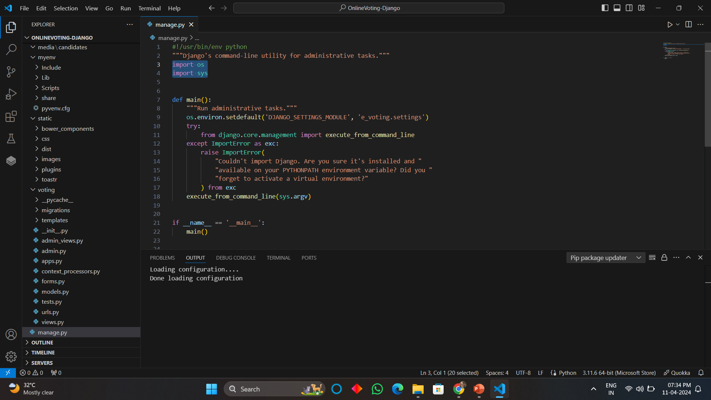
Homepage

Slide 12
About-Us-Page
1.Credibility:
The "About Us" page establishes credibility by providing information about the organization's history, mission, and team members
2.Mission and Values:
It communicates the organization's mission, values, and objectives in promoting democratic participation and decision-making.
3. Community Engagement:
The page showcases the organization's commitment to community engagement and empowerment through the voting process, inspiring active participation.
4. Contact Information:
Users can easily reach out with questions, feedback, or inquiries about the voting application through the contact information provided on the page.

Slide 13
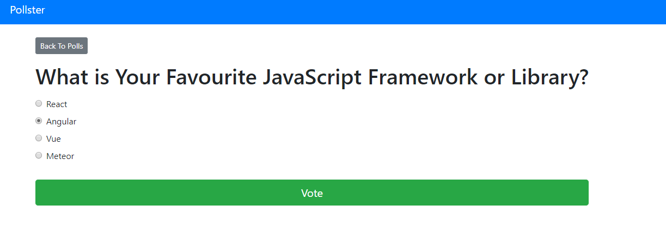
Blog-Page

Slide 14
Future Enhancements:
For future enhancements, the voting web application built on the Django framework could incorporate advanced features such as blockchain-based voting for enhanced security and transparency, integration with biometric authentication systems for secure user verification, and support for mobile voting applications to increase accessibility and participation. Additionally, implementing machine learning algorithms could improve the accuracy of result predictions and identify potential anomalies or irregularities in voting patterns. Furthermore, enhancing the user interface with interactive data visualization tools could provide users with deeper insights into voting trends and results. Overall, these enhancements would further elevate the voting web application's capabilities, ensuring its effectiveness, security, and inclusivity in democratic decision-making processes.

Slide 15
Conclusion
In conclusion, the voting web application developed using the Django framework represents a significant advancement in facilitating democratic decision-making processes. Through robust security measures, intuitive user interface design, and scalable architecture, the application provides a reliable platform for users to participate in voting events securely and transparently. The utilization of Django's built-in functionalities, coupled with potential future enhancements such as blockchain integration and machine learning algorithms, ensures the continuous evolution and effectiveness of the application in meeting the evolving needs of democratic societies. Overall, the voting web application stands as a testament to the power of technology in fostering inclusive and transparent governance, empowering citizens to actively engage in shaping their communities and societies.
Source :

Slide 16
Thank You!
Notes:
Thank You !!

